Slide 1
Chapter 8: Memory Management

Slide 2
Chapter 8: Memory Management
Background
Swapping
Contiguous Allocation
Paging
Segmentation
Segmentation with Paging

Slide 3
Background
Program must be brought into memory and placed within a process for it to be run
Input queue – collection of processes on the disk that are waiting to be brought into memory to run the program
User programs go through several steps before being run

Slide 4
Binding of Instructions and Data to Memory
Address binding of instructions and data to memory addresses can
happen at three different stages
Compile time: If memory location known a priori, absolute code can be generated; must recompile code if starting location changes
Load time: Must generate relocatable code if memory location is not known at compile time.（静态（地址）重定位）
Execution time: Binding delayed until run time if the process can be moved during its execution from one memory segment to another. Need hardware support for address maps (e.g., base and limit registers). （动态（地址）重定位）

Slide 5
Logical vs. Physical Address Space
The concept of a logical address space that is bound to a separate physical address space is central to proper memory management
  Logical address – generated by the CPU; also referred to as virtual address
  Physical address – address seen by the memory unit
Logical and physical addresses are the same in compile-time and load-time address-binding schemes; logical (virtual) and physical addresses differ in execution-time address-binding scheme

Slide 6
地址重定位(续)
地址重定位完成把相对地址转换成内存中的绝对地址，这个过程称为地址映射（map）。按照重定位的时机，可分为静态重定位和动态重定位。
静态重定位
静态重定位是在程序执行之前进行重定位。它根据装配模块将要装入的内存起始地址，直接修改装配模块中的有关使用地址的指令。
在图中以“0”作为参考地址的装配模块，要装入以1000为起始地址的存储空间。显然在装入程序之前，程序必须做一些修改才能正确运行。

Slide 7
静态地址重定位(图)
0： 10000：
  100： LOAD 1，2500 10100： LOAD 1，12500
  2500： 365 12500： 365
  2600： 12600：
  程序的地址空间 内存的地址空间
  例如：LOAD 1，2500 这条指令是把相对地址为2500的存储单元的内容365装入1号累加器。而这时内容为365的存储单元的实际物理地址为12500（起始地址10000+相对地址2500），所以LOAD 1，2500 这条指令中的直接地址码要作相应的修改，即改为LOAD 1，12500。

Slide 8
静态地址重定位(续)
在程序中需要修改的位置称为重定位项。程序装入内存中的起始地址称为重定位因子。为了支持静态重定位，连接程序在生成统一地址空间和装配模块时，还应产生一个重定位项表。所以操作系统的装入程序要把装入模块和重定位项表一起装入内存。由装配模块的实际装入起始地址得到重定位因子，然后取重定位项，加上重定位因子得到欲修改位置的实际地址，最后对实际地址中的内容再加上重定位因子，从而完成指令代码的修改。当完成重定位后，就可以启动程序执行。
静态重定位虽然有无须硬件支持的优点，但是也存在明显的缺点：一是程序重定位以后就不能在内存中移动；二是要求程序的存储空间是连续的，不能把程序存储到若干个不连续的区域中。

Slide 9
动态地址重定位
动态重定位
动态重定位是指在程序执行过程中进行地址重定位，即在每次访问内存单元前才进行地址变换。动态重定位可使装配模块不加任何修改就装入内存，但是它需要硬件—重定位寄存器的支持。下图给出了动态重定位的示意图。
程序的目标模块在装入内存时，与地址有关的指令都无须进行修改，如在图中LOAD 1，2500这条指令中仍保持相对地址2500。当该模块被操作系统调度到处理机上执行时，操作系统首先把该模块装入的实际起始地址减去目标模块的相对基地址（图中该模块的基地址为0），然后将其差值装入重定位寄存器。当CPU取一条访问内存的指令时，地址变换硬件逻辑自动将指令中的相对地址与重定位寄存器中的值相加，再根据和值作为内存的绝对地址去访问该单元的数据。

Slide 10
Dynamic relocation using a relocation register（动态重定位的示意图）
  relocation register（重定位寄存器）
  10000
  0： 10000：
100：LOAD 1，2500 10100： LOAD 1，2500
+
2500：365 12500：365
2600： 12600：
  程序的地址空间 内存的地址空间
10000

Slide 11
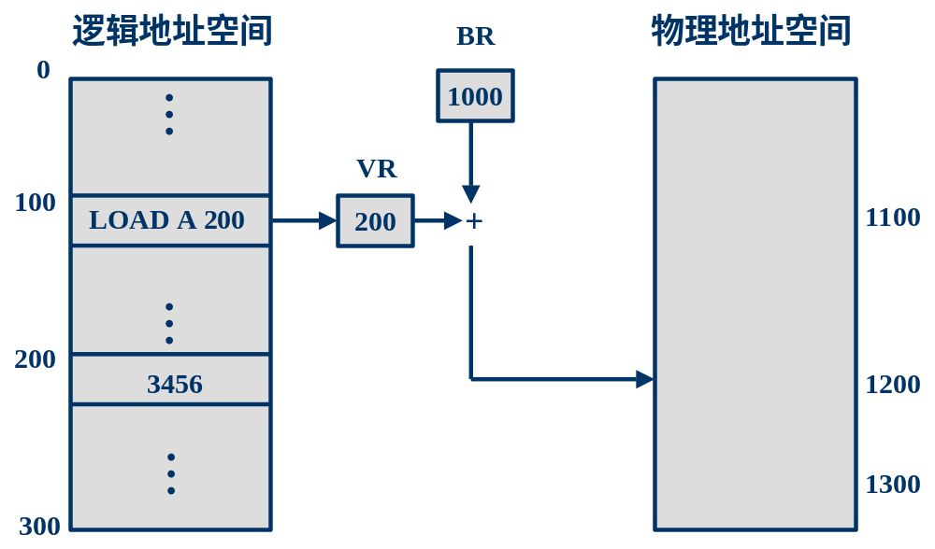
重定位寄存器
内存管理单元MMU
地址映射

Slide 12
Memory-Management Unit (MMU)
Hardware device that maps virtual to physical address
In MMU scheme, the value in the relocation register is added to every address generated by a user process at the time it is sent to memory
The user program deals with logical addresses; it never sees the real physical addresses

Slide 13

Multistep Processing of a User Program

Slide 14
链接方法 仅在装入或执行时期地址绑定
把用户源程序编译后链接到一个以0地址为始地址的线性或多维逻辑地址空间（或虚地址空间）。
  静态链接
  动态链接
    装入时链接
    运行时链接

Slide 15
静态链接(static-linking)
静态链接是在生成可执行文件时进行的。
  在目标模块中记录符号地址，而在可执行文件中改写为指令直接使用的数字地址。
0
Module A
0
Module A
call "function1"
call L+F
L-1
L-1
0
L
Module B
Module B
"function1"
"function1"
地址变换
L+F
function1(){
F
function1(){
...
...
}
M-1
}
L+M-1

Slide 16
动态链接(dynamic-linking)：
在装入或运行时进行链接。
通常被链接的共享代码称为动态链接库(DLL, Dynamic-Link Library)或共享库(shared library)。
动态链接库或共享库本身是已链接的可执行代码，只是它不能独立执行，而需要通过其他程序调用来执行

Slide 17
装入时链接
使用这种方式调用动态链接库的应用程序将在其文件头中包含一张动态库导入表。表中包含了这个应用程序需要使用哪个DLL(以文件名标识)以及调用了这个DLL中的哪个函数。
装入时检查应用程序文件头的这张动态库导入表，并根据导入表中的内容，依次装入每个动态库。同时得到动态库中输出的供应用程序调用的函数的地址，将该地址填回到表中。应用程序调用动态库中的函数时，将调用相应导入表中指明的动态库函数的地址(这个时候将不再通过函数名，然后在动态库中查找这个函数的地址，因为这一工作在应用程序装入的时候已经完成)。

Slide 18
运行时链接
由API函数LoadLibrary或LoadLibraryEx函数来装入动态库（共享引用计数增加1）
通过GetProcAddress函数来获得函数的地址，并且传递给函数相应的参数，调用这个函数。
在动态库用完后，可通过FreeLibrary函数来释放动态库资源（共享引用计数减1）。

Slide 19
运行时动态链接的例子（Windows）
HINSTANCE hInstLibrary; //模块句柄定义
DWORD (WINAPI *InstallStatusMIF)(char*, char*, char*, char*, char*, char*, char*, BOOL); //函数指针定义
if (hInstLibrary = LoadLibrary("ismif32.dll")) //映射
{
InstallStatusMIF = (DWORD (WINAPI *)(char*,char*,char*, char*, char*, char*, char*, BOOL)) GetProcAddress(hInstLibrary, "InstallStatusMIF"); //获得函数指针
if (InstallStatusMIF)
{
if (InstallStatusMIF(“office97”, “Microsoft”, “Office 97”, “998.999”, “ENU”, “1234”, ”Completed successfully”, TRUE) !=0)
//调用DLL模块中的函数
{ …… }
}
FreeLibrary(hInstLibrary); //拆除映射
}

Slide 20
动态链接的优缺点
优点
  共享：多个进程可以共用一个DLL，节省内存，减少文件交换。
  部分装入：一个进程可以将多种操作分散在不同的DLL中实现，而只将当前操作相应的DLL装入内存。
  便于局部代码修改：即便于代码升级和代码重用；只要函数的接口参数（输入和输出）不变，则修改函数及其DLL，无需对可执行文件重新编译或链接。
  便于运行环境适应：调用不同的DLL，就可以适应多种使用环境和提供不同功能。如：不同的显示卡只需厂商为其提供特定的DLL，而OS和应用程序不必修改。
缺点：
  链接开销：增加了程序执行时的链接开销；
  管理开销：程序由多个文件组成，增加管理复杂度。

Slide 21
Dynamic Linking
Linking postponed until execution time
Small piece of code, stub, used to locate the appropriate memory-resident library routine
Stub replaces itself with the address of the routine, and executes the routine
Operating system needed to check if routine is in processes’ memory address
Dynamic linking is particularly useful for libraries

Slide 22
Dynamic Loading
Routine is not loaded until it is called
Better memory-space utilization; unused routine is never loaded
Useful when large amounts of code are needed to handle infrequently occurring cases
No special support from the operating system is required implemented through program design

Slide 23
Dynamic Loading--覆盖技术
用户程序自己控制内外存之间的数据交换。要求用户清楚地了解程序的结构，并指定各程序段调入内存的先后次序。
  把程序划分为若干个功能上相对独立的程序段，按照其自身的逻辑结构将那些不会同时执行的程序段共享同一块内存区域
  程序段先保存在磁盘上，当有关程序段的前一部分执行结束，把后续程序段调入内存，覆盖前面的程序段（内存“扩大”了）
  覆盖：一个作业的若干程序段，或几个作业的某些部分共享某一个存储空间
  一般要求作业各模块之间有明确的调用结构，程序员要向系统指明覆盖结构，然后由由操作系统完成自动覆盖

Slide 24
覆盖技术例（图）
A
8K
进程X的常驻区
A（8K）
B
8K
C
10K
C
B
覆盖区0
（10K）
D
12K
E
4K
F
10K
E
D
F
覆盖区1
（12K）
进程X的调用结构

Slide 25
覆盖技术缺点
1）用户负担很大；
2）程序段的最大长度仍受内存容量限制；
3）不能实现虚拟存储器。

Slide 26
Swapping
A process can be swapped temporarily out of memory to a backing store, and then brought back into memory for continued execution
Backing store – fast disk large enough to accommodate copies of all memory images for all users; must provide direct access to these memory images
Roll out, roll in – swapping variant used for priority-based scheduling algorithms; lower-priority process is swapped out so higher-priority process can be loaded and executed
Major part of swap time is transfer time; total transfer time is directly proportional to the amount of memory swapped
Modified versions of swapping are found on many systems (i.e., UNIX, Linux, and Windows)

Slide 27

Schematic View of Swapping

Slide 28
Contiguous Allocation
Main memory usually into two partitions:
  Resident operating system, usually held in low memory with interrupt vector
  User processes then held in high memory
Single-partition allocation
Multiple-partition allocation
Relocation
  Relocation-register scheme used to protect user processes from each other, and from changing operating-system code and data
  Relocation register contains value of smallest physical address; limit register contains range of logical addresses – each logical address must be less than the limit register

Slide 29
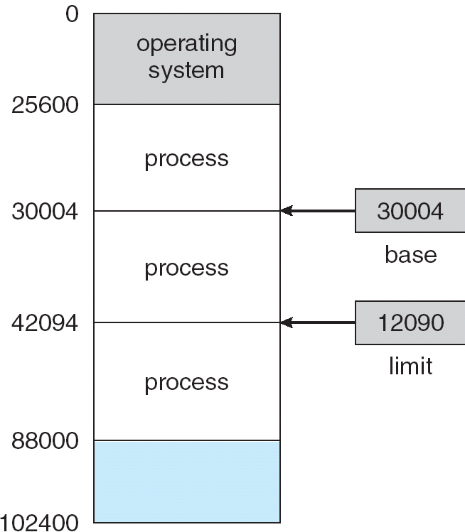
A base and a limit register define a logical address space

Slide 30

HW address protection with base and limit registers

Slide 31
固定分区的进程队列
当有许多进程要使用分区，而分区不够时
  可使进程进入等待队列：
    固定分区的进程队列：
      多队列适用于大小不等的固定分区；
      单队列适用于大小相同的固定分区，也可用于大小不等的情况
  可以和覆盖、交换技术配合使用。

Slide 32
多个等待队列
分区4
分区3
分区2
分区1
操作系统
分区4
分区3
分区2
分区1
操作系统
单个等待队列

Slide 33
分区的数据结构
操作系统包含以下信息
a) 已分配的分区
b) 空闲的分区
采用的数据结构：分区表，或分区链表－－记录分区的大小和使用情况
分区表，或分区链表
  可以只记录空闲分区，也可以同时记录空闲和占用分区
  分区表中，表项数目随着内存的分配和释放而动态改变，可以规定最大表项数目。
  分区表可以划分为两个表格：空闲分区表，占用分区表。从而减小每个表格长度。空闲分区表中按不同分配算法相应对表项排序。

Slide 34
空闲区表
始址 | 长度 | 标志
15K | 23K | 未分配
48K | 20K | 未分配
80K | 30K | 未分配
 |  | 空
 |  | 空
0K
15K
38K
48K
已分配区表
始址 | 长度 | 标志
0K | 15K | J1
38K | 10K | J2
68K | 12K | J3
110K | 10K | J4
 |  | 空
 |  | 空
68K
80K
110K
120K

Slide 35
动态分区法
动态创建分区：在装入程序时按其初始要求分配，或在其执行过程中通过系统调用进行分配或改变分区大小。
OS
OS
OS
OS
process 1
process 1
process 1
process 1
process 4
process 4
process 2
process 5
process 3
process 3
process 3
process 3

Slide 36
某时刻状态
空闲区表
始址 | 长度 | 标志
15K | 23K | 未分配
48K | 20K | 未分配
80K | 30K | 未分配
 |  | 空
 |  | 空
0K
15K
38K
48K
已分配区表
始址 | 长度 | 标志
0K | 15K | P1
38K | 10K | P2
68K | 12K | P3
110K | 10K | P4
 |  | 空
 |  | 空
68K
80K
110K
120K

Slide 37
一段时间后
空闲区表
始址 | 长度 | 标志
15K | 23K | 未分配
48K | 20K | 未分配
98K | 12K | 未分配
 |  | 空
 |  | 空
0K
15K
38K
48K
已分配区表
始址 | 长度 | 标志
0K | 15K | P1
38K | 10K | P2
68K | 12K | J3
110K | 10K | P4
80K | 5K | P5
85K | 13K | P6
68K
80K
85K
98K
110K
120K

Slide 38
Contiguous Allocation (Cont.)
Multiple-partition allocation
  Hole – block of available memory; holes of various size are scattered throughout memory
  When a process arrives, it is allocated memory from a hole large enough to accommodate it
  Operating system maintains information about:
  a) allocated partitions b) free partitions (hole)
OS
OS
OS
OS
process 5
process 5
process 5
process 5
process 9
process 9
process 8
process 10
process 2
process 2
process 2
process 2

Slide 39
Dynamic Storage-Allocation Problem
How to satisfy a request of size n from a list of free holes
First-fit: Allocate the first hole that is big enough
Best-fit: Allocate the smallest hole that is big enough; must search entire list, unless ordered by size. Produces the smallest leftover hole.
Worst-fit: Allocate the largest hole; must also search entire list. Produces the largest leftover hole.
First-fit and best-fit better than worst-fit in terms of speed and storage utilization

Slide 40
Fragmentation
External Fragmentation – total memory space exists to satisfy a request, but it is not contiguous
Internal Fragmentation – allocated memory may be slightly larger than requested memory; this size difference is memory internal to a partition, but not being used
Reduce external fragmentation by compaction
  Shuffle memory contents to place all free memory together in one large block
  Compaction is possible only if relocation is dynamic, and is done at execution time
  I/O problem
    Latch job in memory while it is involved in I/O
    Do I/O only into OS buffers

Slide 41
Paging
Logical address space of a process can be noncontiguous; process is allocated physical memory whenever the latter is available
Divide physical memory into fixed-sized blocks called frames (size is power of 2, between 512 bytes and 8192 bytes)
Divide logical memory into blocks of same size called pages.
Keep track of all free frames
To run a program of size n pages, need to find n free frames and load program
Set up a page table to translate logical to physical addresses
Internal fragmentation

Slide 42
Address Translation Scheme
Address generated by CPU is divided into:
  Page number (p) – used as an index into a page table which contains base address of each page in physical memory
  Page offset (d) – combined with base address to define the physical memory address that is sent to the memory unit

Slide 43
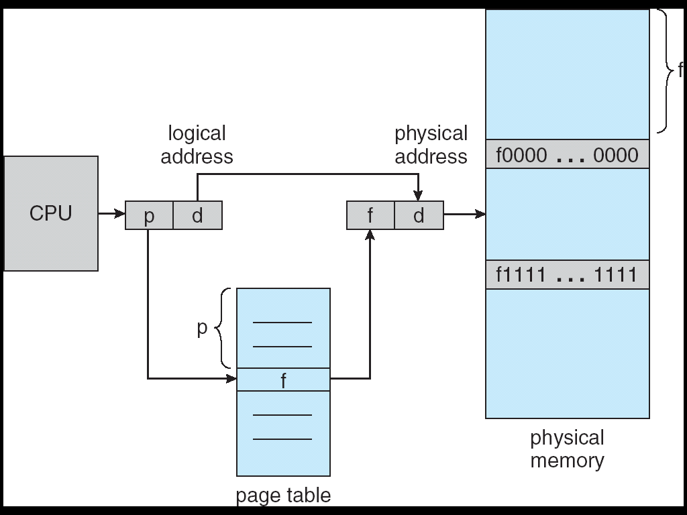
Address Translation Architecture

Slide 44

Paging Example

Slide 45

Paging Example

Slide 46

Free Frames
Before allocation
After allocation

Slide 47
Implementation of Page Table
Page table is kept in main memory
Page-table base register (PTBR) points to the page table
Page-table length register (PRLR) indicates size of the page table
In this scheme every data/instruction access requires two memory accesses. One for the page table and one for the data/instruction.
The two memory access problem can be solved by the use of a special fast-lookup hardware cache called associative memory or translation look-aside buffers (TLBs)

Slide 48
Associative Memory
Associative memory – parallel search
Address translation (A´, A´´)
  If A´ is in associative register, get frame # out
  Otherwise get frame # from page table in memory
Page #
Frame #

Slide 49

Paging Hardware With TLB

Slide 50
PTBR
PTLR
Logical address
b
l
Page No.(P) offset (d)
no
+
P>=l
yes
Page Table
TLB快表
p’
illegal page
p
p’
.
.
.
P’
d
Address Translation
Physical address

Slide 51
Effective Access Time
Associative Lookup = ε time unit
Assume memory cycle time is 1 microsecond
Hit ratio – percentage of times that a page number is found in the associative registers; ration related to number of associative registers
Hit ratio = α
Effective Access Time (EAT)
EAT = (1 + ε) α + (2 + ε)(1 – α)
= 2 + ε – α

Slide 52
Memory Protection
Memory protection implemented by associating protection bit with each frame
Valid-invalid bit attached to each entry in the page table:
  “valid” indicates that the associated page is in the process’ logical address space, and is thus a legal page
  “invalid” indicates that the page is not in the process’ logical address space

Slide 53

Valid (v) or Invalid (i) Bit In A Page Table

Slide 54
Page Table Structure
Hierarchical Paging
Hashed Page Tables
Inverted Page Tables

Slide 55
Hierarchical Page Tables
Break up the logical address space into multiple page tables
A simple technique is a two-level page table

Slide 56
Two-Level Paging Example
A logical address (on 32-bit machine with 4K page size) is divided into:
  a page number consisting of 20 bits
  a page offset consisting of 12 bits
Since the page table is paged, the page number is further divided into:
  a 10-bit page number
  a 10-bit page offset
Thus, a logical address is as follows:
where p_{i} is an index into the outer page table, and p₂ is the displacement within the page of the outer page table
page number
page offset
p_{i}
p₂
d
10
10
12

Slide 57

Two-Level Page-Table Scheme

Slide 58

Address-Translation Scheme
Address-translation scheme for a two-level 32-bit paging architecture

Slide 59
Hashed Page Tables
Common in address spaces > 32 bits
The virtual page number is hashed into a page table. This page table contains a chain of elements hashing to the same location.
Virtual page numbers are compared in this chain searching for a match. If a match is found, the corresponding physical frame is extracted.

Slide 60

Hashed Page Table

Slide 61
Inverted Page Table
One entry for each real page of memory
Entry consists of the virtual address of the page stored in that real memory location, with information about the process that owns that page
Decreases memory needed to store each page table, but increases time needed to search the table when a page reference occurs
Use hash table to limit the search to one — or at most a few — page-table entries

Slide 62

Inverted Page Table Architecture

Slide 63
Shared Pages
Shared code
  One copy of read-only (reentrant) code shared among processes (i.e., text editors, compilers, window systems).
  Shared code must appear in same location in the logical address space of all processes
Private code and data
  Each process keeps a separate copy of the code and data
  The pages for the private code and data can appear anywhere in the logical address space

Slide 64
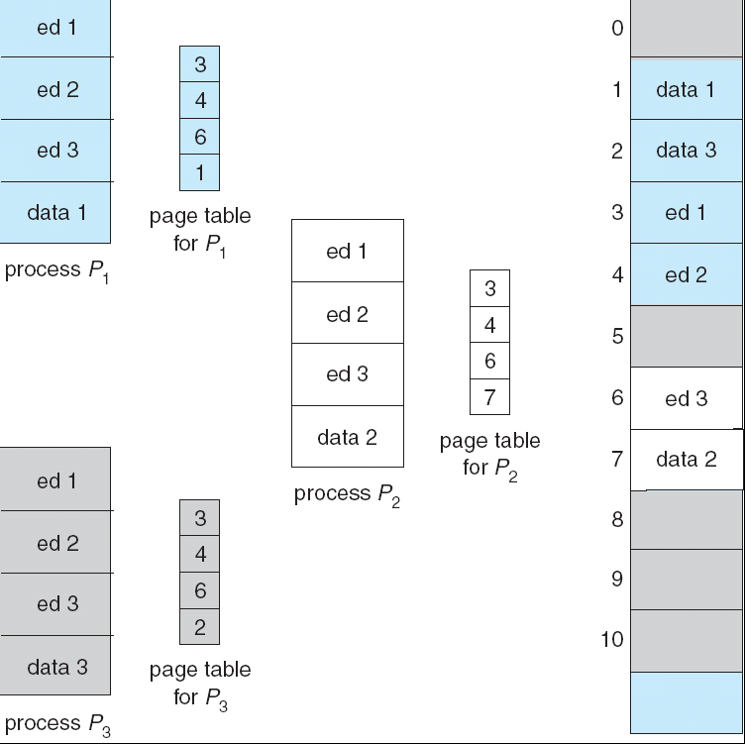
Shared Pages Example

Slide 65
Segmentation
Memory-management scheme that supports user view of memory
A program is a collection of segments. A segment is a logical unit such as:
main program,
procedure,
function,
method,
object,
local variables, global variables,
common block,
stack,
symbol table, arrays

Slide 66

User’s View of a Program

Slide 67
Logical View of Segmentation
1
1
4
2
3
4
2
3
user space
physical memory space

Slide 68
Segmentation Architecture
Logical address consists of a two tuple:
<segment-number, offset>,
Segment table – maps two-dimensional physical addresses; each table entry has:
  base – contains the starting physical address where the segments reside in memory
  limit – specifies the length of the segment
Segment-table base register (STBR) points to the segment table’s location in memory
Segment-table length register (STLR) indicates number of segments used by a program;
segment number s is legal if s < STLR

Slide 69
Segmentation Architecture (Cont.)
Relocation.
  dynamic
  by segment table
Sharing.
  shared segments
  same segment number
Allocation.
  first fit/best fit
  external fragmentation

Slide 70
Segmentation Architecture (Cont.)
Protection. With each entry in segment table associate:
  validation bit = 0 ⇒ illegal segment
  read/write/execute privileges
Protection bits associated with segments; code sharing occurs at segment level
Since segments vary in length, memory allocation is a dynamic storage-allocation problem
A segmentation example is shown in the following diagram

Slide 71

Address Translation Architecture

Slide 72
段表始址寄存器
段表长度寄存器
逻辑地址
C_{b}
C_{l}
段号S 段内地址d
+
比较
S>= C_{l}
地址越界
段表
快表
d>=1
地址越界
比较
S
l
b
.
.
.
l
b
d>=1
比较
地址越界
b + d
地址映射及存储保护机制
物理地址

Slide 73

Example of Segmentation

Slide 74
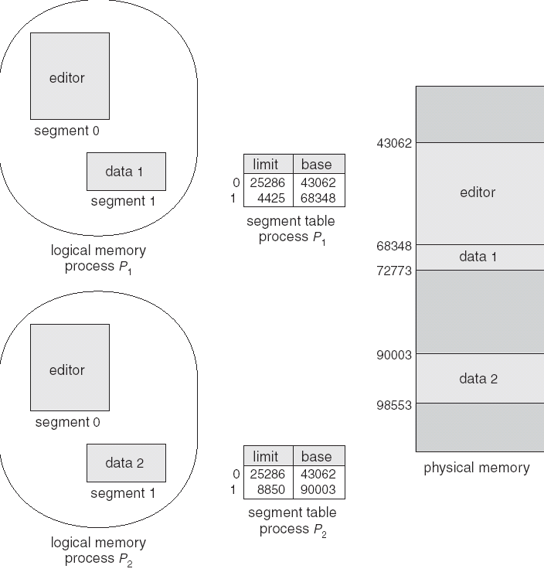
Sharing of Segments

Slide 75
Segmentation with Paging – MULTICS
The MULTICS system solved problems of external fragmentation and lengthy search times by paging the segments
Solution differs from pure segmentation in that the segment-table entry contains not the base address of the segment, but rather the base address of a page table for this segment

Slide 76

MULTICS Address Translation Scheme

Slide 77
Segmentation with Paging – Intel 386
As shown in the following diagram, the Intel 386 uses segmentation with paging for memory management with a two-level paging scheme

Slide 78

Intel 30386 Address Translation

Slide 79
Linux on Intel 80x86
Uses minimal segmentation to keep memory management implementation more portable
Uses 6 segments:
  Kernel code
  Kernel data
  User code (shared by all user processes, using logical addresses)
  User data (likewise shared)
  Task-state (per-process hardware context)
  LDT
Uses 2 protection levels:
  Kernel mode
  User mode

Slide 80
End of Chapter 8

